Slide 1


RADAR
The Future
of Urban Planning
Abhinav Kumar-S24CSEU0621
DIVYANSH DWIVEDI-S24CSEU0854
CHARAN REDDY-S24CSEU0563

Slide 2
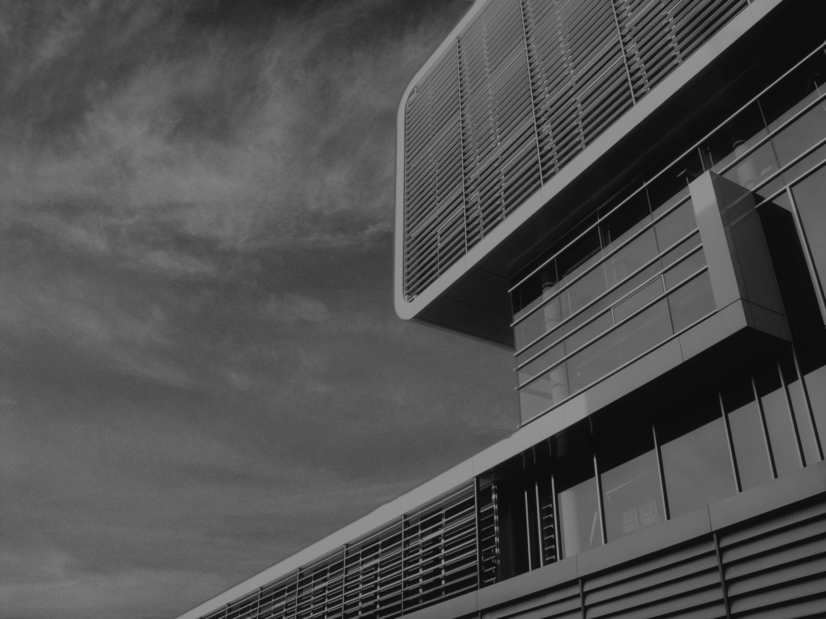
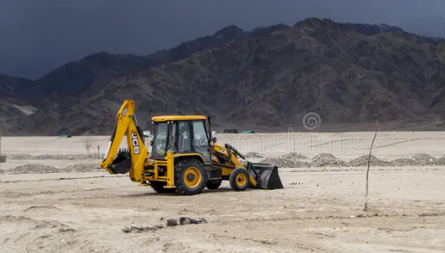
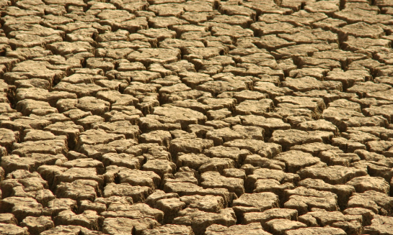
Problem Statement
Urban planners face a critical conflict between accommodating rapid city growth and preserving environmental sustainability. Current manual methods for evaluating land allocation are too slow and subjective to keep pace with development demands, often resulting in decisions that unintentionally degrade local ecosystems by failing to account for cumulative neighborhood-level health metrics in real-time.

Slide 3
PROPOSED SOLUTION
The proposed solution is an automated Decision Support System that transforms raw satellite imagery into actionable policy decisions. The system leverages a deep learning model to perform real-time land cover analysis, accurately identifying areas of vegetation, water, and existing structures. This AI-generated data is then fed into a backend "rules engine" which automatically checks the proposal against key environmental policies, such as neighborhood green-space minimums. This entire process delivers an instant, objective, and data-driven "Approved" or "Denied" recommendation to the planner via an interactive web dashboard.

Slide 4
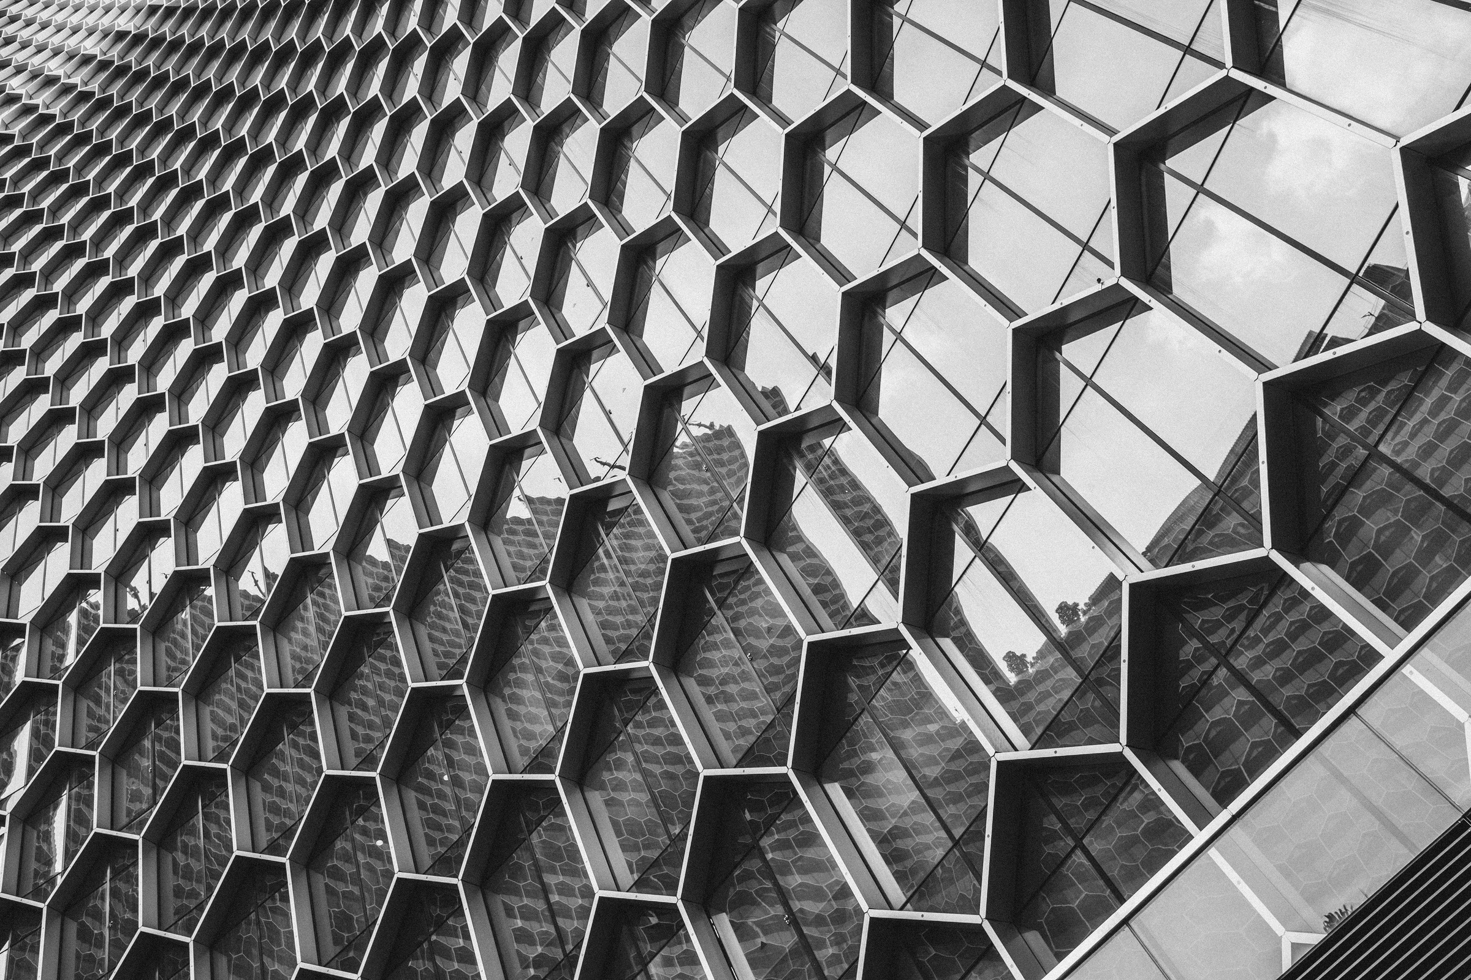



GOALS AND OBJECTIVES
Tech Implementation & Automation
Policy Enforcement & Sustainability
Train a U-Net deep learning model to accurately perform semantic segmentation on satellite imagery, identifying all key land cover classes (Vegetation, Water, Building, etc.)
Develop a robust FastAPI backend API capable of loading the AI model and running on-demand inference on new or existing images in under a second.
Automate the entire analytical workflow, from image input to a final JSON decision, eliminating the need for manual data processing.
Implement a flexible "Rules Engine" that programmatically checks the AI-generated data against configurable policies (e.g., the 15% neighborhood vegetation rule).
Remove subjective human error and bias from initial development assessments by providing a standardized, repeatable analysis.
Ensure that development proposals are vetted against "Local Health" standards, preventing the degradation of environmentally sensitive or "nature-poor" neighborhoods.
Empowering Users
Diverse Categories
Incorporating AI

Slide 5
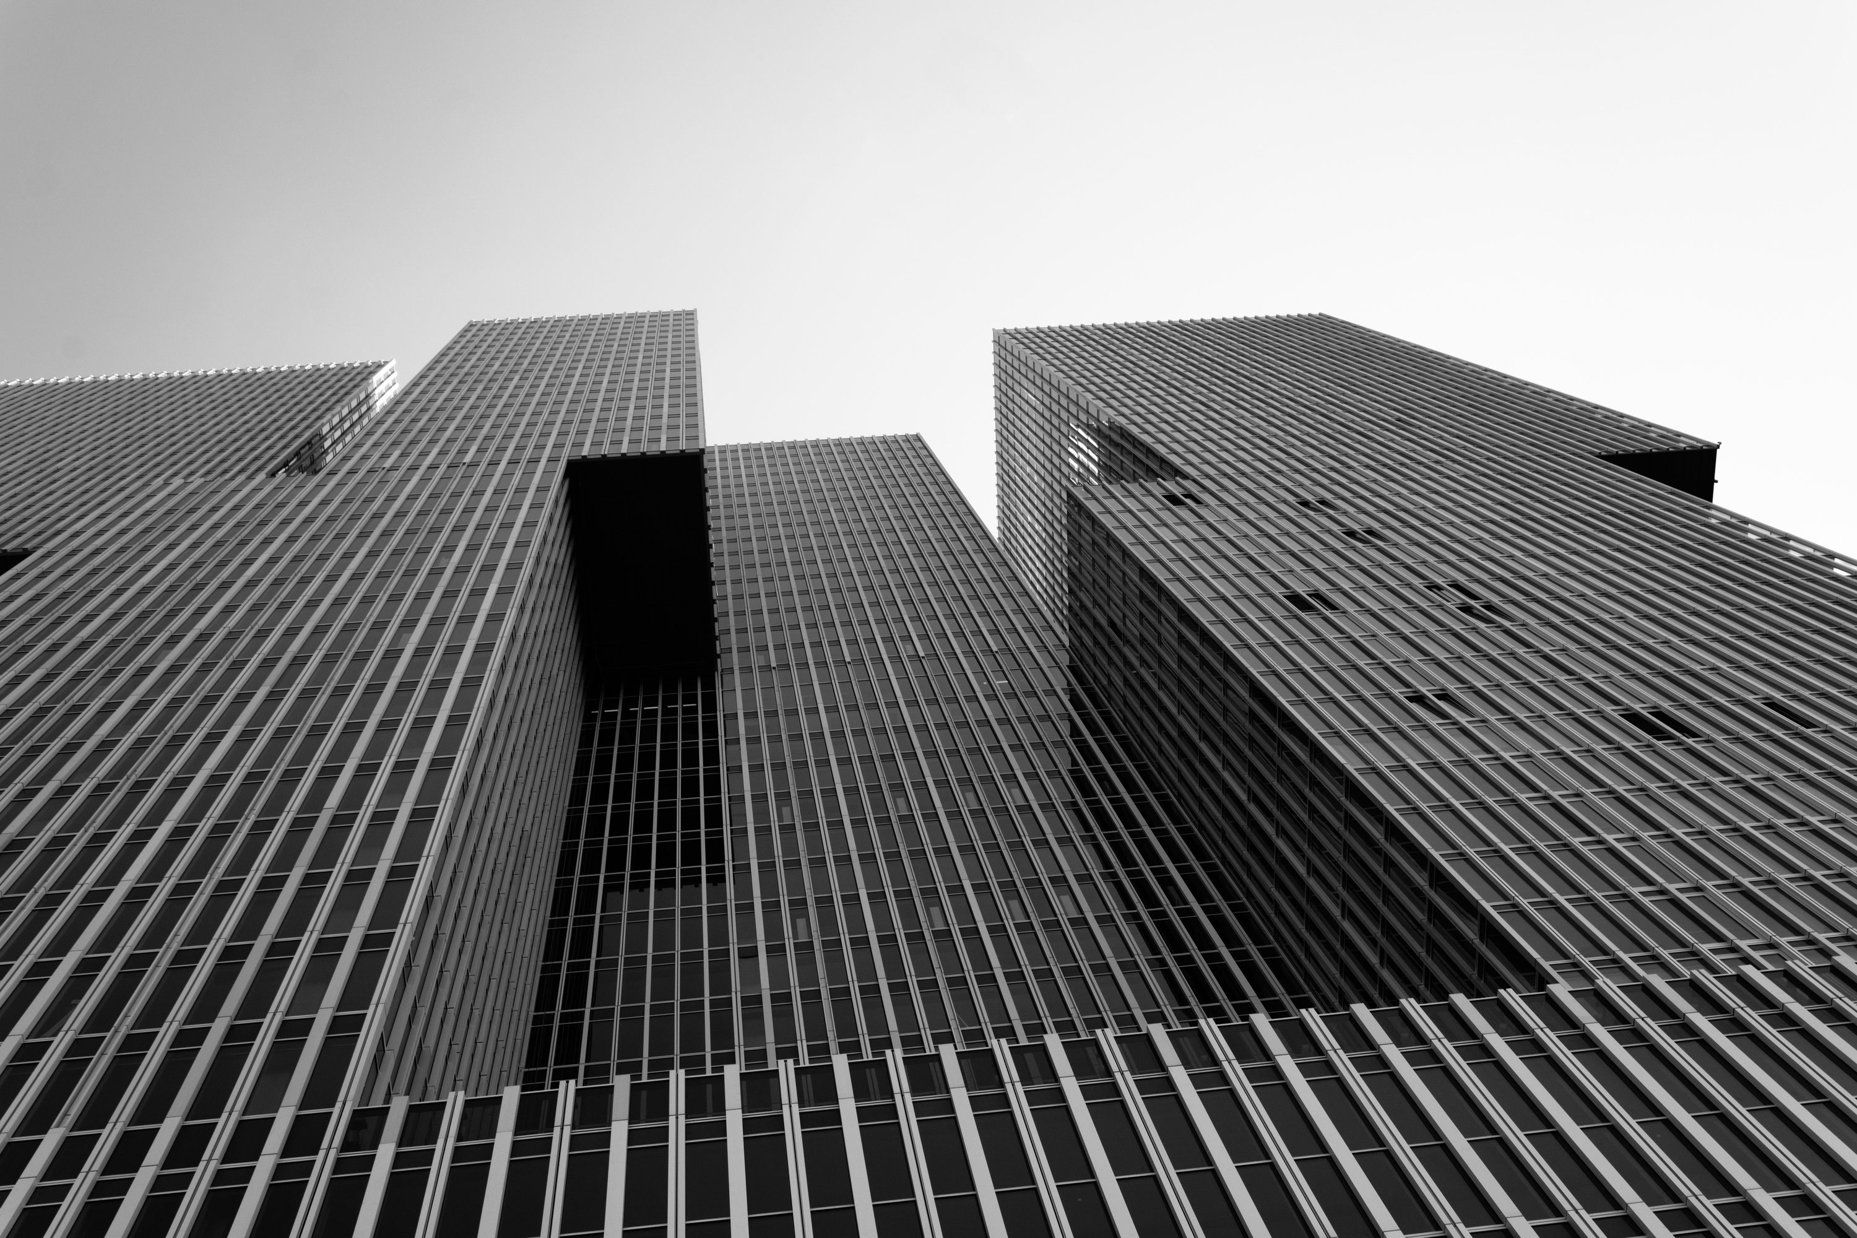











TECHNOLOGY USED
ML & Data Processing
Backend & API
Frontend & User Interface
PyTorch
TorchVision
NumPy
Pillow
Python
FastAPI
Uvicorn
HTML
CSS
Java Script

Slide 6
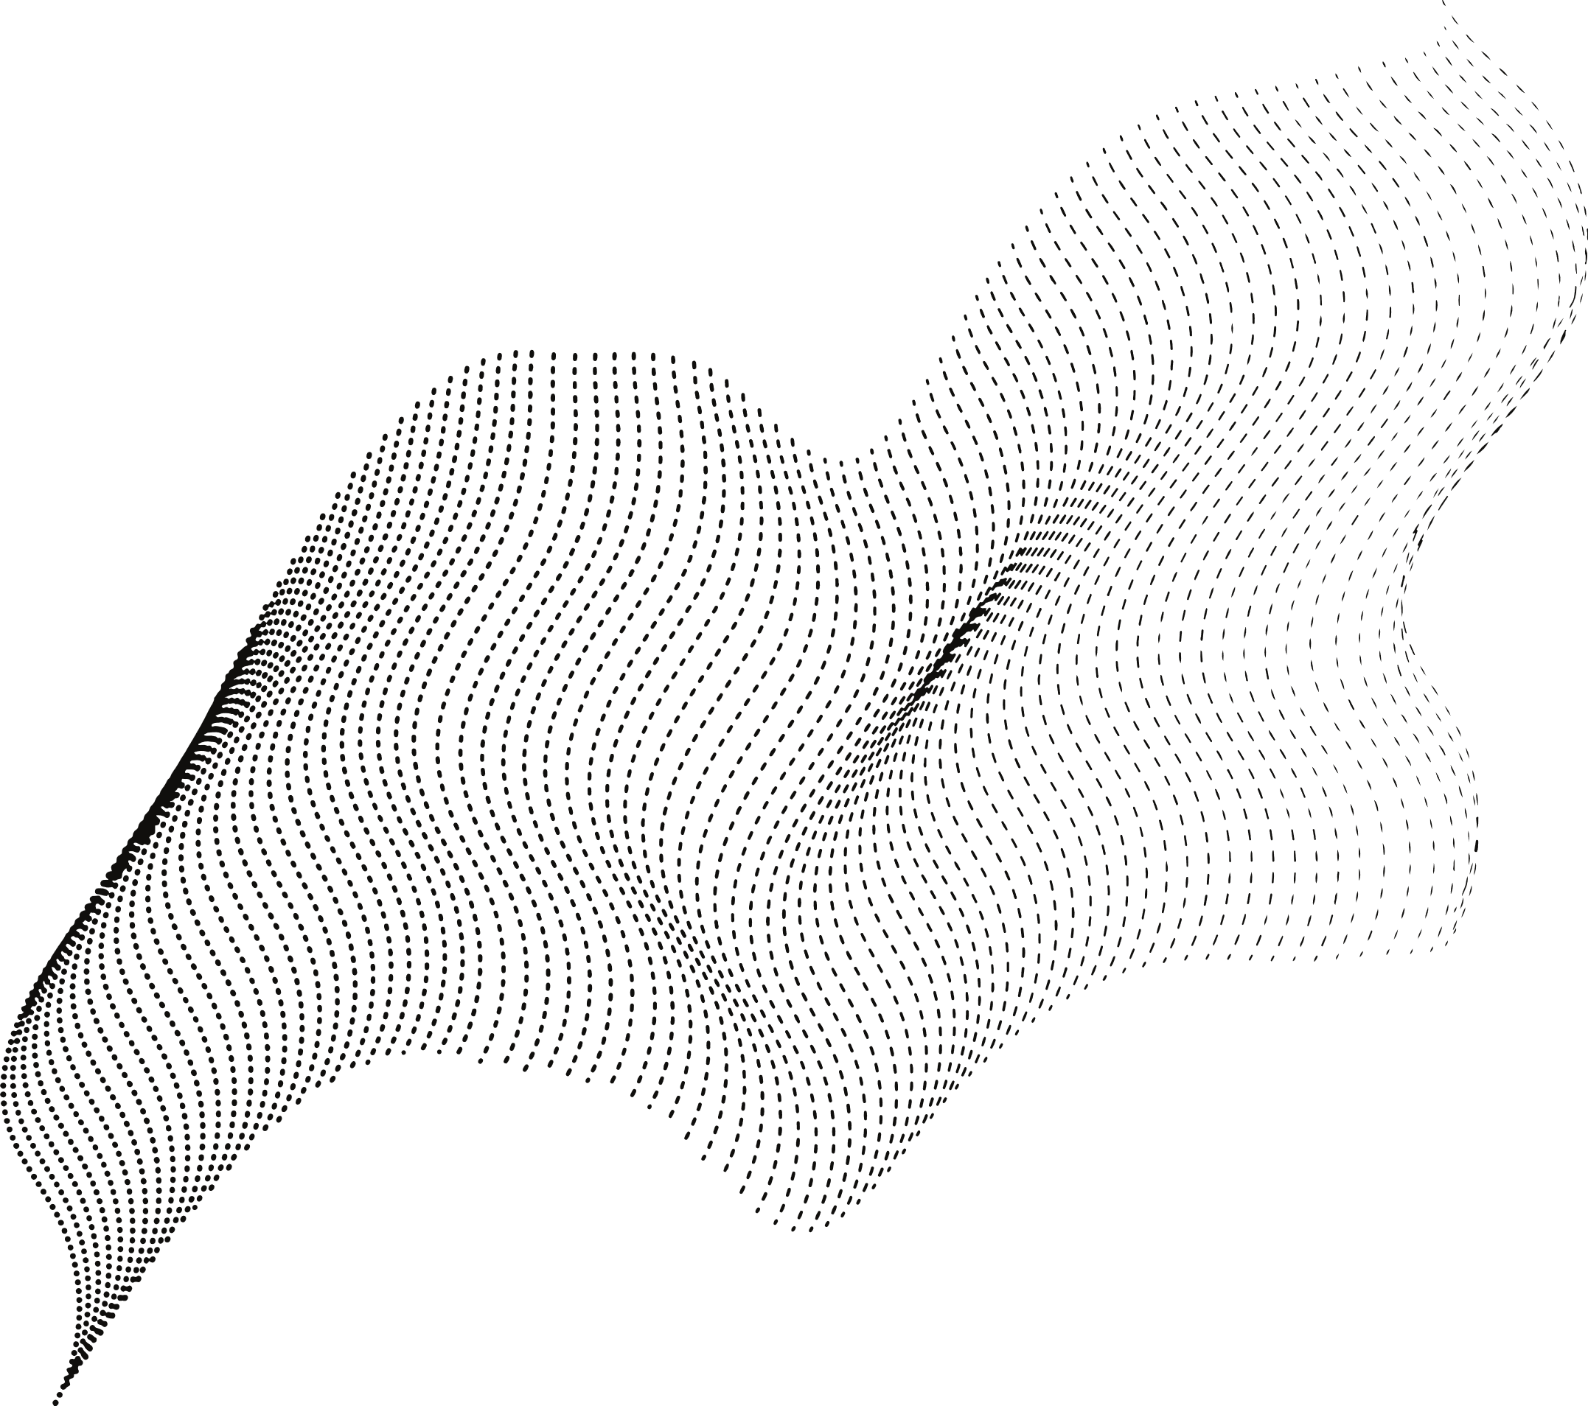
AI Segmentation (U-Net)
Health Rules Engine
Interactive 3x3 Grid Analysis
The system's core is a trained U-Net deep learning model that performs on-demand semantic segmentation. It instantly analyzes any satellite image to identify and classify every pixel into categories like Vegetation, Water, Building, and Road.
It uses a sophisticated logic engine. It enforces a "Local Health" policy, automatically checking if the entire neighborhood (the full image) meets predefined environmental standards
It features a 3x3 grid overlay. This allows users to perform sector-by-sector assessments by simply clicking a specific sub-plot to run the AI and rules engine on that targeted area.
KEY FEATURES
OF RADAR
Transparent Analysis Metrics
On-Demand Upload Capability
The system doesn't just give a final answer; it shows its work. A panel displays the exact metrics used in the decision, building trust and providing clear, data-driven justification.
Instant Decision Support
The system is not limited to its internal database. A key feature is the ability for users (like city planners) to upload their own .jpg or .png satellite images, allowing for the immediate analysis of new plots
It provides immediate, actionable feedback. It replaces a slow, manual review process with a real-time "Approved" or "Denied" decision as soon as the analysis is complete

Slide 7
Future Prospects
Enhancement of Model & Data :
Expanding the Dataset
Increasing Classes
Exploring Advanced Architectures(ViT, DeepLabv3+)
Replacing Static Images with a Live Map
Custom Polygon Drawing
Third-Party API Integration
Scalable Model Inference

Slide 8
Thank You!

